Slide 1

Railway Reservation system
​
P Abhinav - AP20110010694
P Abhiram - AP20110010667
P Sai Monika - AP20110010637
K Anil Kumar - AP20110010654
CSE-J
Department of computer science and engineering
SRM University,AP.

Slide 2
Introduction
The Railway Reservation system is a web application that provides a centralized platform for managing various aspects of railway reservation.It encompasses features such as login credentials, seat availability, train status, payment options, ticket booking etc.
The Railway Reservation System is a modern and effective platform designed to make the process of booking train tickets easier and more efficient. The website also provides user friendly environment. This system provides users the ability to easily book seats, plan trips, and maintain bookings for hassle-free travel experiences.
The Railway Reservation System makes use of advanced technology in this age of the internet to give travellers access to a user-friendly interface on a variety of gadgets, including computers, tablets, and smartphones. Passengers may quickly look up available trains, view schedules, pick their preferred seats, and make safe online payments by using this technology.

Slide 3
The Railway Reservation System's huge database, which holds an infinite amount of data regarding train routes, stations, rates, and seat availability, is one of its standout characteristics. Passengers are provided with accurate and current information using real-time data, enabling them to make sensible travel-planning decisions.
In addition, the Railway Reservation System meets the various demands of travellers by providing a variety of ticket choices, including first class, second class, sleeper, and more. Additionally, it offers special regard for travellers with certain needs, such as children, older citizens, and those with disabilities.
Queues at railway stations and depending on agents to book tickets are a thing of the past courtesy to the Railway Reservation System. Today, travellers may easily purchase train tickets from the convenience of their homes or while on the road, saving both time and effort.
The Railway Reservation System offers a seamless, dependable, and effective platform for purchasing train tickets, enhancing your travel experience whether you are a frequent traveller or only planning a single trip. With our advanced reservation system, travel with ease and confidence on your upcoming train excursion.

Slide 4
Existing System
Advantages of Railway Reservation system web software
Users have the convenience of making reservations for trains via the internet at any time and from any location. There is no need for customers to go to physical ticket counters or rely on intermediaries because they can access the system through a web browser on their laptops, smartphones, or tablets.
Web-based reservation systems are available 24/7, every day of the week, unlike physical ticket counters with set business hours. Bookings can be made whenever it is most convenient for the passenger, even on weekends and legal holidays.
Web-based reservation systems offer a variety of secure online payment options, such as credit/debit cards, net banking, and digital wallets.In order to ensure a smooth and convenient transaction procedure, passengers can select the payment option that best suits them.
During the online reservation procedure, passengers can view seat arrangements and choose their preferred seats. With the help of this tool, travellers can select seats according to their preferences, such as window or aisle seats, locations near restrooms, or particular coach sections.wallets.

Slide 5
The whole process of booking tickets is simple and effective with a railway reservation web programme. In just a few minutes, travellers may find available trains, verify seat availability, and confirm their reservations, saving time and avoiding the bother of standing in long lines at ticket booths.
Typically, web-based reservation systems have options for changing and cancelling tickets. Subject to any applicable laws and regulations, passengers may simply alter their travel dates, change their boarding locations, or cancel tickets online.
Physical tickets and printed receipts are not required when purchasing tickets online through a web-based system. The option for passengers to carry their electronic tickets reduces paperwork and helps the environment.

Slide 6
Disadvantages of Railway Reservation system web software
Technical Issues: Like any software, you may encounter technical issues such as system bugs, system downtime or connectivity problems.These issues disrupt your operations and may require prompt technical support to resolve.
Cost: Extra convenience fee will be charged in the form of taxes. So you are required to pay additional amount only in case of online transaction.
Dependency on Internet: The system relies on stable internet connection. So if your internet connection is slow or experiencing downtime, it may hinder your payment or disrupt your operations.
Security Risks: The software systems are susceptible to security threats such as data breaches and unauthorised access. So it is crucial to implement robust security measures.
Insufficient personal assistance : Web software does not directly contact with customers way traditional ticket counters do. Some users might prefer or need individual assistance with directions, explanations, or addressing certain booking needs. Users could get a less personalised experience if there is no personal support.

Slide 7
System Requirements
Software Requirements
Operating System: The Railway reservation system may be compatible with popular Operating systems such as Windows, MacOS, or Linux.
Web Browser: As it is a web based application, Software like Apache or Nginx to handle web-based communication and serve web pages.
Database Management System: The software may require a specific database management system such as MySQL or Microsoft SQL server to store and retrieve data.
Programming Frameworks: Depending on the software , it may require specific programming languages like HTML, PHP or Java for development and execution.
User Interface: A user-friendly web interface for customers to search, book, and manage their reservations.

Slide 8
Hardware Requirements
Computer: There is a need of computer or server. The requirements of the software will determine the specification.
Internet Connection: For web-based systems to function properly and process online payments, a quick and dependable internet connection is required.
Storage: Effective enough storage capacity to store user data, ticket information, and system logs.

Slide 9
Proposed System
User Authentication: Implement a user authentication system to allow users to log in with unique credentials. The system will have a login page where users can enter their registered email address and password to authenticate their identity. The system will check the submitted information with the data stored when the user enters their login credentials. The user will be given access to the system if the supplied information matches the records.
Search and booking options: Trains can be found by passengers using a variety of parameters, including dates, desired classes, departure/arrival stations, and seat availability. Passengers will be able to make reservations using the system's real-time information on train schedules, fares, and available seats.

Slide 10
Automated Seat Allocation: Using effective algorithms, the system will automatically assign seats to travellers based on their preferences, space availability, and ticket class. Upon successful booking, passengers will receive an immediate confirmation of their seat reservations.
Ticket Modification and Cancellation: Through their user profiles, travellers will be able to quickly adjust their travel dates, boarding locations, or ticket cancellations under the proposed system. To ensure an easy procedure, specific instructions and rules regarding ticket change and cancellation will be made available.

Slide 11
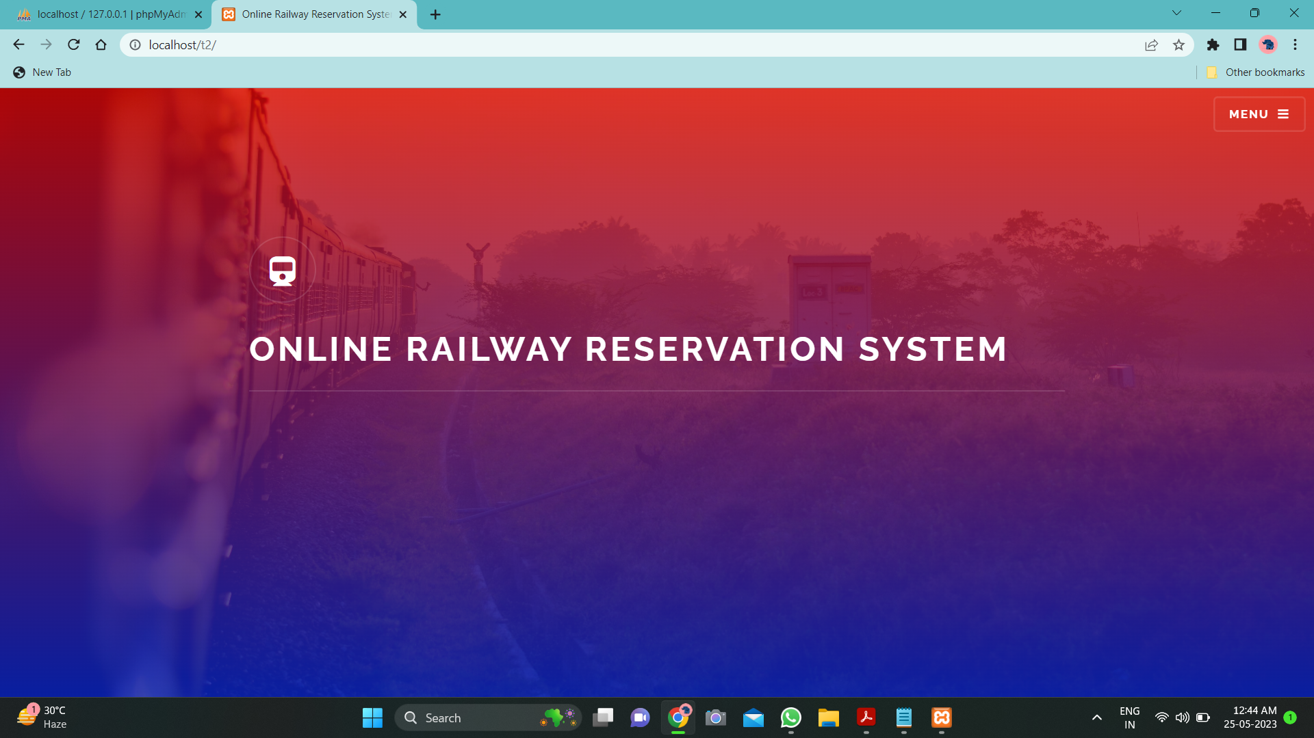
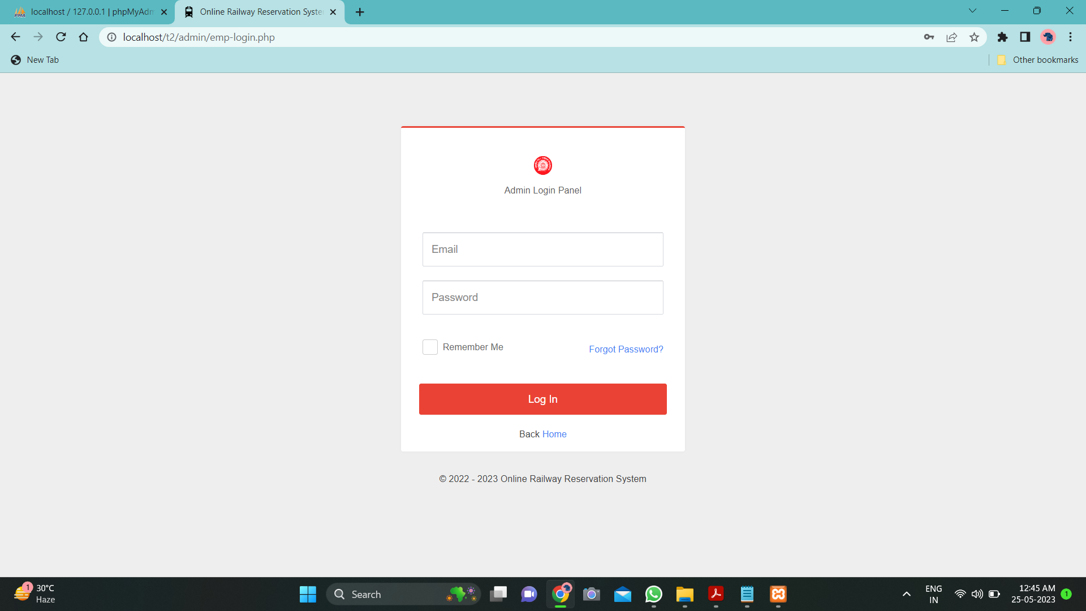
Results

Slide 12
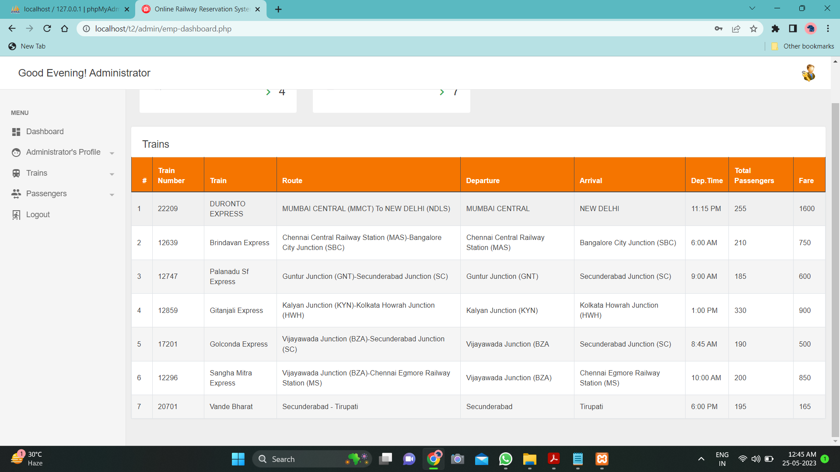
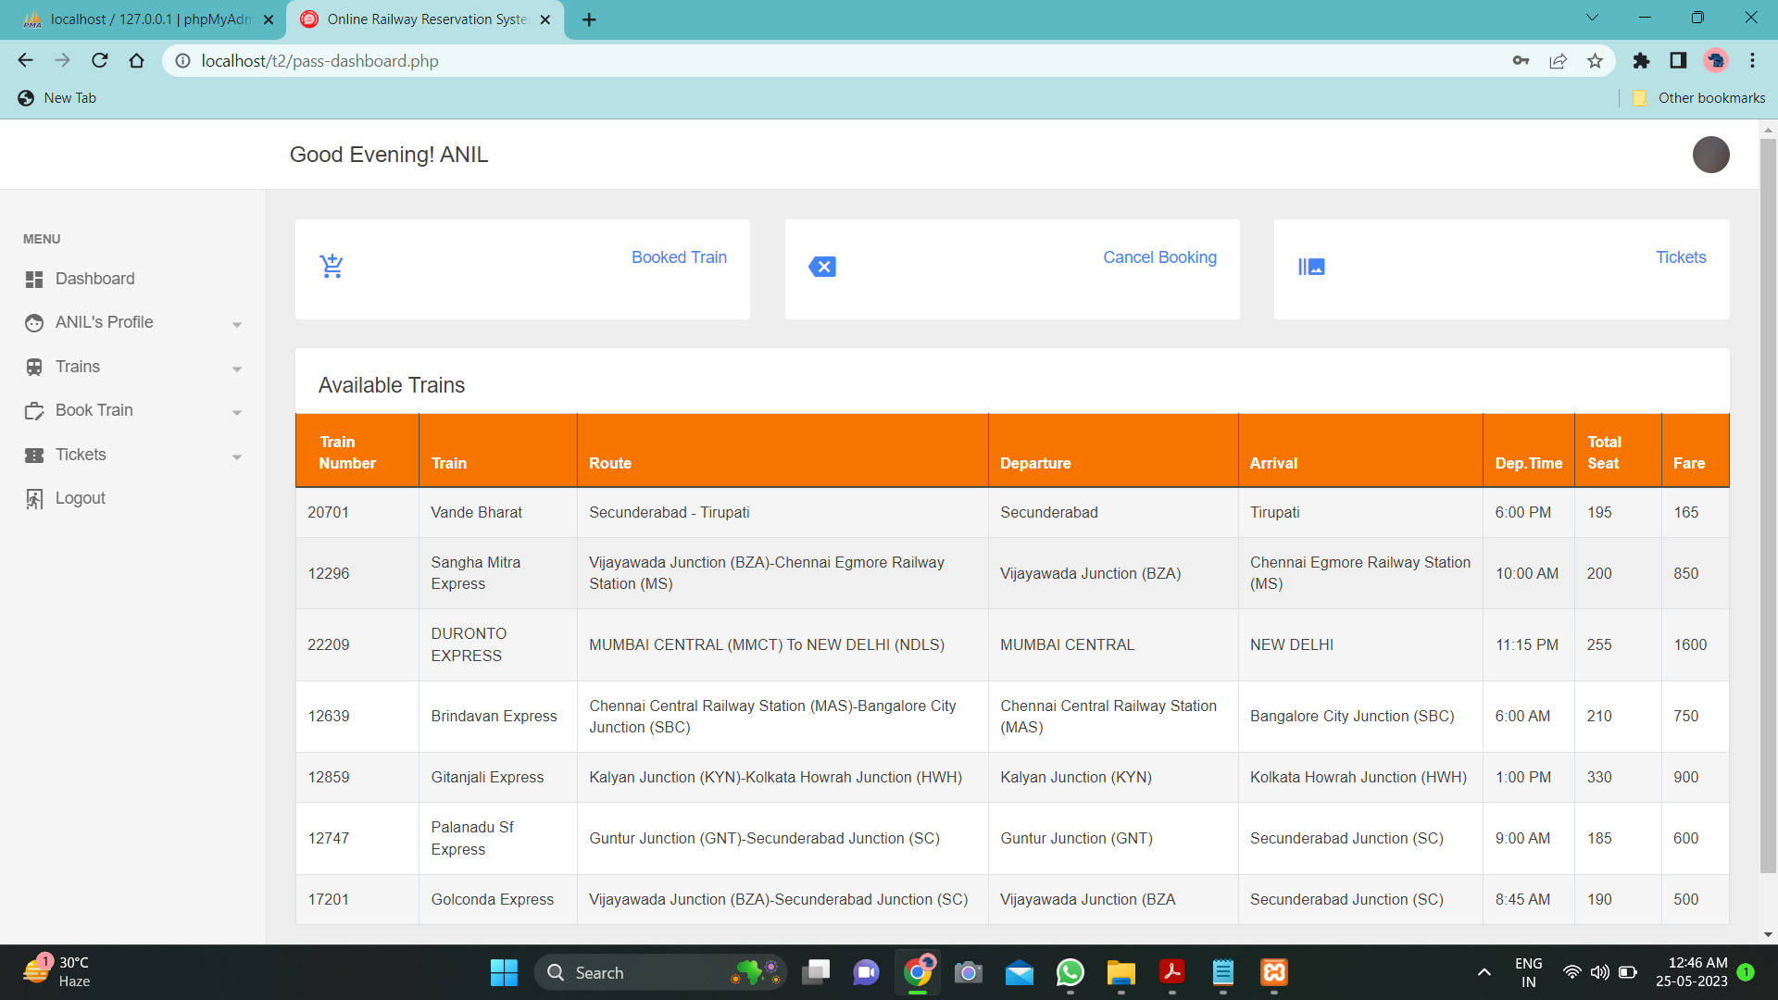

Slide 13
Conclusion
While railway reservation systems have great advantages they also face certain challenges. Growing trust and credibility is crucial as users may have concerns about booking and the reliability of the platform to do ticket bookings. Overcoming these challenges is essential to maintain user satisfaction and loyalty.
In conclusion, railway reservation systems have revolutionized the ticket booking landscape, offering convenience,variety and competitive pricing to the users. Despite the challenges to trust and user experience, the prospects for the railway reservation system are promising. By addressing these challenges, leveraging technological advancements and adapting to emerging trends, railway reservation system can continue to thrive and meet the evolving needs of users.

Slide 14
References
Indian Railway website
https://www.irctc.co.in/nget/train-search
2. Indians Railway board directorate
https://indianrailways.gov.in/railwayboard/uploads/directorate/cis/Progress_of_IT_projects_CRIS.pdf
"Design and Development of a Web-Based Railway Reservation System" – Research by
CH Vamsi Krishna
https://www.ijcaonline.org/archives/volume4/number11/708-0422
"Development of Online Reservation System for Indian Railways" - Research paper by
T. M. K. Nandhini
https://www.hindawi.com/journals/jat/2022/7685375

Slide 15


